Slide 1

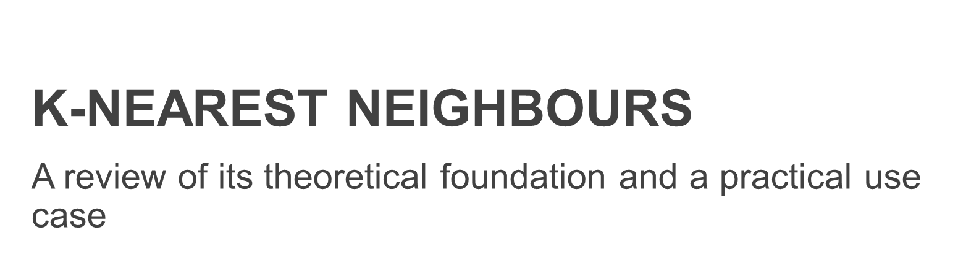


Slide 2
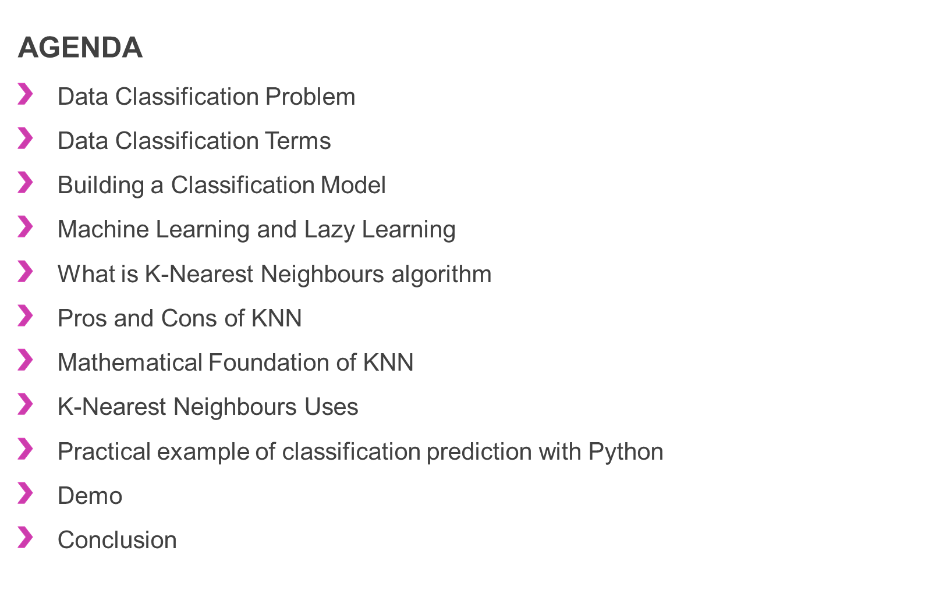

Slide 3
Data Classification Problem
Classification can be performed on structured or unstructured data.
Classification is a technique where we categorize data into a given number of classes.
The main goal of a classification problem is to identify the category/class to which a new data will fall under.
K-Nearest Neighbours is one of the most used classification algorithm
Others are:
Logistic Regression
Naïve Bayes
Stochastic Gradient Descent
Decision Tree
Random Forest
Support Vector Machine (subject of a previous presentation)

Slide 4
Data Classification Terms
Classifier: An algorithm that maps the input data to a specific category.
Classification model: A classification model tries to draw some conclusion from the input values given for training. It will predict the class labels/categories for the new data.
Feature: A feature is an individual measurable property of a phenomenon being observed.
Binary Classification: Classification task with two possible outcomes. Eg: Gender classification (Male / Female)
Multi class classification: Classification with more than two classes. In multi class classification each sample is assigned to one and only one target label. Eg: An animal can be cat or dog but not both at the same time
Multi label classification: Classification task where each sample is mapped to a set of target labels (more than one class). Eg: A news article can be about sports, a person, and location at the same time.

Slide 5
Building a Classification Model
There are 4 steps required by the building of a classification model:
Initialize the classifier to be used.
Train the classifier: All classifiers in scikit-learn uses a fit(X, y) method to fit the model(training) for the given train data X and train label y.
Predict the target: Given an unlabeled observation X, the predict(X) returns the predicted label y.
Evaluate the classifier model

Slide 6
Machine Learning and Lazy Learning
ML’s lazy learning is a learning method in which generalization of the training data is delayed until a query is made to the system
This is opposed to eager learning, where the system tries to generalize the training data before receiving queries.
Lazy learning is used by online recommendation systems ("people who viewed/purchased/listened to this movie/item/tune also ...") where data set is continuously updated with new entries
Because of the continuous update, the "training data" would be rendered obsolete in a relatively short time
Therefore, one cannot really talk of a "training phase".
Lazy classifiers are most useful for large, continuously changing datasets with few attributes that are commonly queried.
One of the most common used algorithms in ML lazy learning is K-Nearest Neighbours or KNN for short.

Slide 7
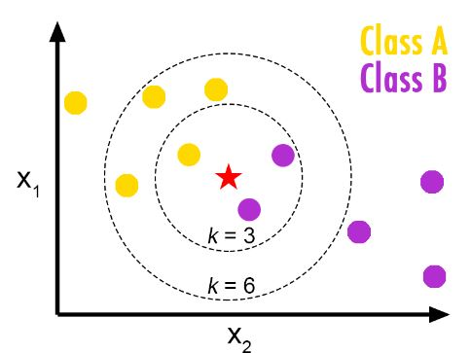
What is K-Nearest Neighbours Algorithm
K-Nearest Neighbors (KNN) is one of the simplest algorithms used in Machine Learning for regression and classification problem
KNN algorithms use data and classify new data points based on similarity measures (e.g. distance function)
Classification is done by a majority vote to its neighbors.
The data is assigned to the class which has the nearest neighbors.
With increased number of nearest neighbors (i.e. value of k), accuracy might increase.

Slide 8
Pros and Cons of KNN
Pros:
it does not attempt to construct a general internal model, but simply stores instances of the training data.
is pretty intuitive and simple: KNN algorithm is very simple to understand and equally easy to implement. To classify the new data point KNN algorithm reads through whole dataset to find out K nearest neighbors.
It has no assumptions: KNN is a non-parametric algorithm which means there are assumptions to be met to implement KNN. Parametric models like linear regression has lots of assumptions to be met by data before it can be implemented which is not the case with KNN.
There is no real training step: KNN does not explicitly build any model, it simply tags the new data entry based learning from historical data. New data entry would be tagged with majority class in the nearest neighbor.
Note: in reality the “training / fitting phase” deals with the optimization of the two hyperparameters that are specific to KNN: 1) k value and 2) distance metric (to be chosen from a list of possible options)
it constantly evolves: Given it’s an instance-based learning; KNN is a memory-based approach. The classifier immediately adapts as we collect new training data. It allows the algorithm to respond quickly to changes in the input during real-time use.
Very easy to implement for multi-class problem: Most of the classifier algorithms are easy to implement for binary problems and needs effort to implement for multi class whereas KNN adjust to multi class without any extra efforts.

Slide 9
Pros and Cons of KNN (cont’d)
Pros:
Can be used both for Classification and Regression: One of the biggest advantages of KNN is that KNN can be used both for classification and regression problems.
Variety of distance criteria to be choose from: KNN algorithm gives user the flexibility to choose distance while building KNN model.
Euclidean Distance
Hamming Distance
Manhattan Distance
Minkowski Distance

Slide 10
Pros and Cons of KNN (cont’d)
Cons:
KNN slow algorithm: KNN might be very easy to implement but as dataset grows efficiency or speed of algorithm declines very fast.
Curse of Dimensionality: KNN works well with small number of input variables but as the numbers of variables grow KNN algorithm struggles to predict the output of new data point.
KNN needs homogeneous features: If you decide to build KNN using a common distance, like Euclidean or Manhattan distances, it is completely necessary that features have the same scale, since absolute differences in features weight the same, i.e., a given distance in feature 1 must means the same for feature 2.
Optimal number of neighbors: One of the biggest issues with KNN is to choose the optimal number of neighbors to be consider while classifying the new data entry.
Imbalanced data causes problems: KNN doesn’t perform well on imbalanced data. If we consider two classes, A and B, and the majority of the training data is labeled as A, then the model will ultimately give a lot of preference to A. This might result in getting the less common class B wrongly classified.
Outlier sensitivity: KNN algorithm is very sensitive to outliers as it simply chose the neighbors based on distance criteria.

Slide 11
Mathematical Foundation of KNN
Very simple and intuitive algorithm:
Load the data
Initialize K to your chosen number of neighbors
For each example in the data
3.1 Calculate the distance between the query example and current example from the data.
3.2 Add the distance and the index of the example to an ordered collection
Sort the ordered collection of distances and indices from smallest to largest (in ascending order) by the distances
Pick the first K entries from the sorted collection
Get the labels of the selected K entries
6.1 If regression, return the mean of the K labels
6.2 If classification, return the mode of the K labels
Note: A number that appears most often is the mode

Slide 12
K-Nearest Neighbours Uses
used by online recommendation systems ("people who viewed/purchased/listened to this movie/item/tune also ...")
where data set is continuously updated with new entries (e.g., new items for sale at Amazon, new movies to view at Netflix, new clips at Youtube, new music at Spotify or Pandora).
is most useful for large, continuously changing datasets with few attributes that are commonly queried.
good even if a large set of attributes exist - for example, books have a year of publication, author/s, publisher, title, edition, ISBN, selling price, etc.
recommendation queries rely on far fewer attributes - e.g., purchase or viewing co-occurrence data, and user ratings of items purchased/viewed

Slide 13
